Slide 1
Nadir calibration (monthly)
300 second nadir pointing for pixel to pixel variations
NON-IMAGING
IMAGING
v

Slide 2
Nadir calibration processing
Same processing as normal altitude profiles except:
No flat field
Result normalized to average value of 1.0

Slide 3
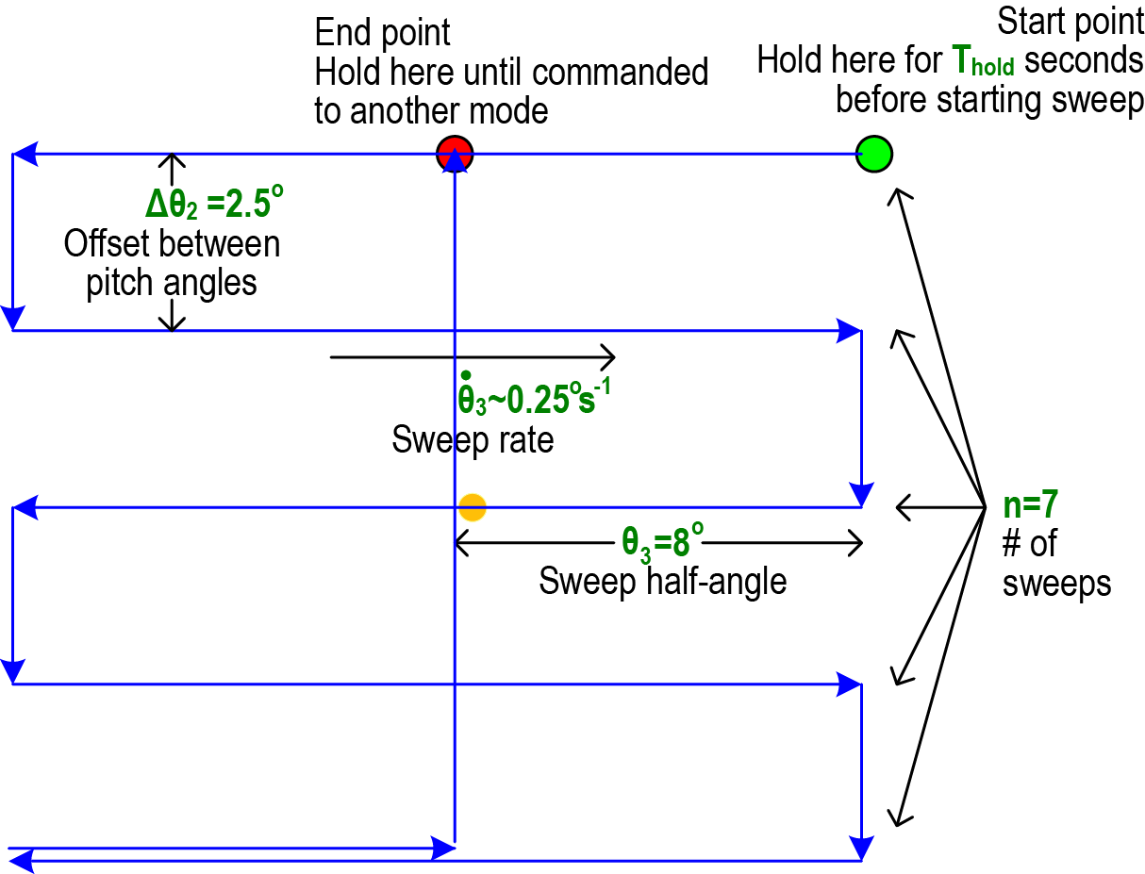
Lunar Calibration (Absolute)
Monthly
~600 second raster sweep of full moon through the field of view.

Slide 4
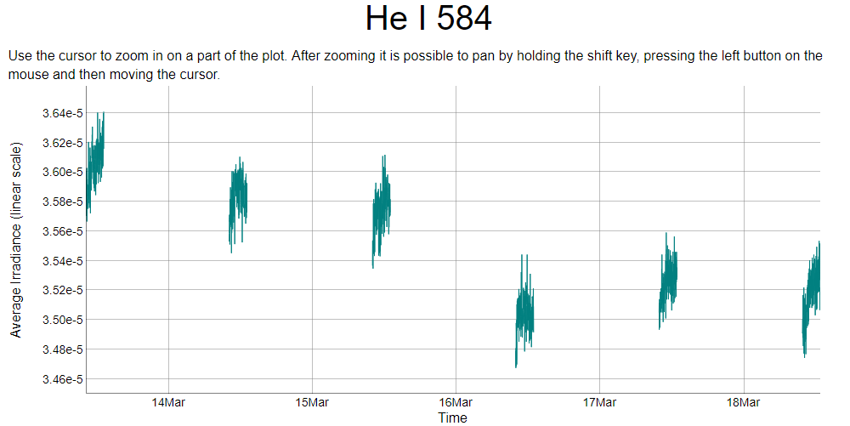
Lunar Calibration Processing
Measured spectrum=Instrument X Lunar Albedo X Geometry X Solar Spectrum
Solar Spectrum from SDO EVE measurements+model

