Slide 1
ICON FUV stellar calibration preparation
Harald U. Frey
Sabine Frey

Slide 2
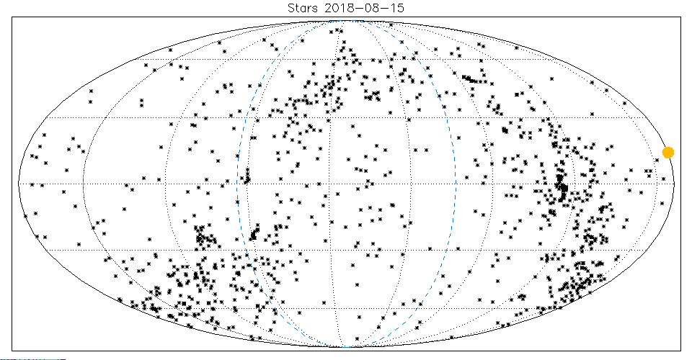
Catalog with 1000 brightest UV stars
Sun
RA=144.5º
RA=0º
Anti-Sun 324.5º

Slide 3
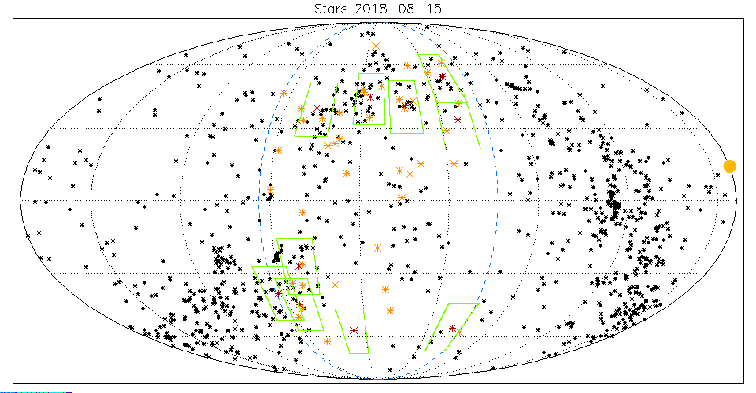
Potential star pointing targets

Slide 4
Top ten targets
This information is given to Sabine to calculate the specific spacecraft slews to point FUV to the best targets without violating mission rules (ram pointing, umbra, no full moon, conflicting calibration of other instrument etc.)

Slide 5
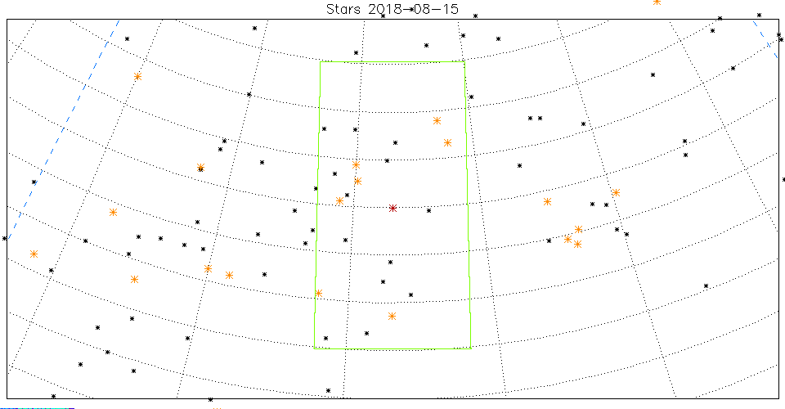
Highest ranked star target

Slide 6
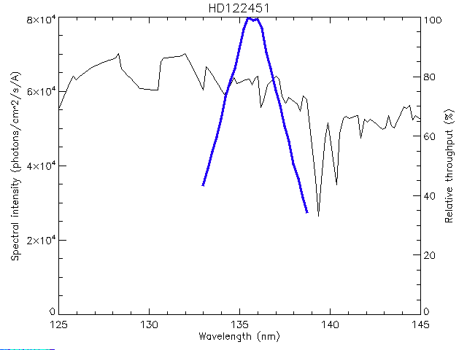
Spectrum example

Slide 7
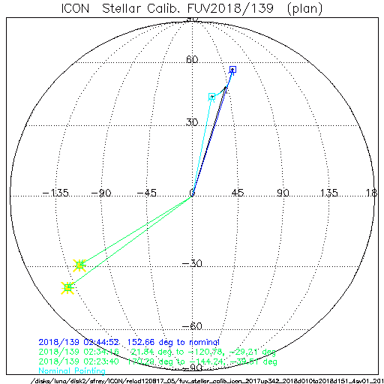
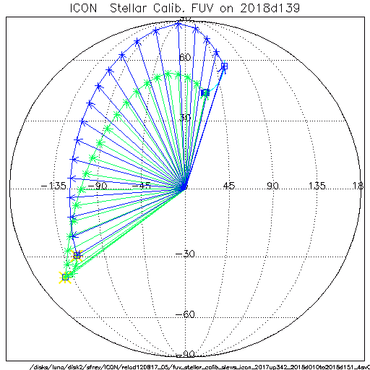
Spacecraft slews and pointing
Umbra : 2018/139 02:18:08.000 - 2018/139 02:49:12.000, duration [min]: 31.066667
Calibration with star at Ra, Dec [deg]: -144.24, -39.51
Slew to target 2018/139 02:23:40.000 - 2018/139 02:25:00.000 80.0 s, 171.8 deg
Observations 2018/139 02:26:16.000 - 2018/139 02:34:16.000 8.0 min
Calibration with star at Ra, Dec [deg]: -120.78, -29.21
Slew to target 2018/139 02:34:16.000 - 2018/139 02:34:28.000 12.0 s, 21.8 deg
Observations 2018/139 02:35:56.000 - 2018/139 02:43:56.000 8.0 min
Slew to Nominal 2018/139 02:43:56.000 - 2018/139 02:45:08.000 72.0 s, 153.6 deg

