Slide 1
First Attempt at ICON FUV Disk Algorithm
Robert R Meier
George Mason University
Science Team Meeting, Berkeley
March 19, 2018

Slide 2
Topics
Single FUV Stripe Example
Formal Relationships
Disk algorithm for small solar zenith angles
Summary
Plans

Slide 3
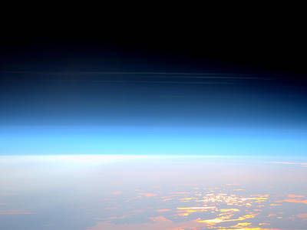
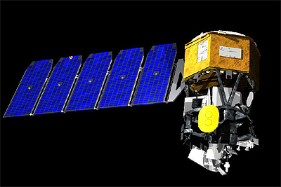
FUV Stripe Imaging
ICON
Limb
Disk

Slide 4
Typical Synthetic FUV Profiles
Limb
Disk

Slide 5
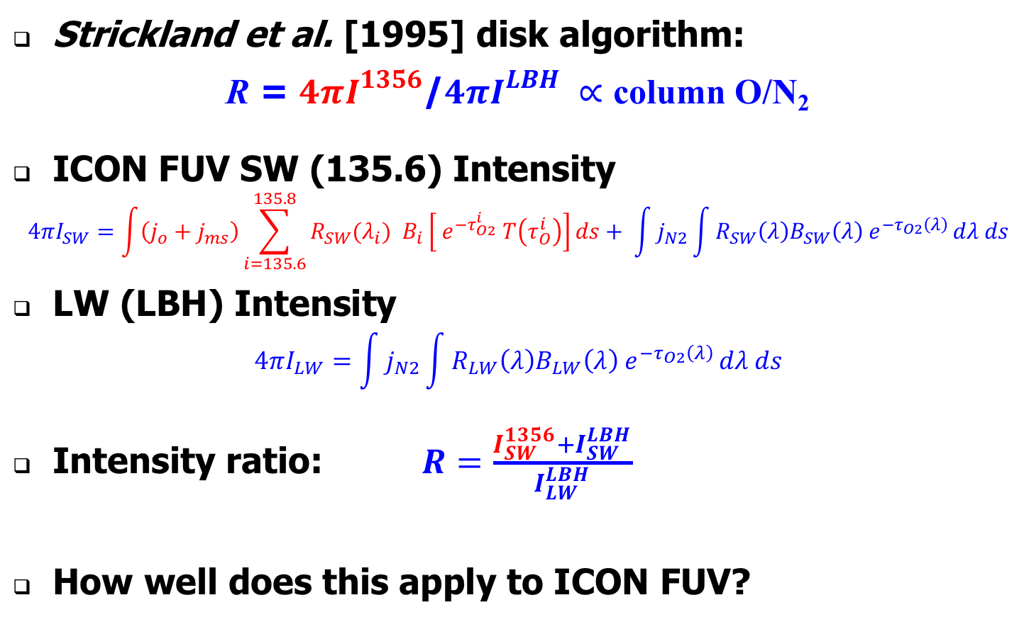
Relationships
Strickland et al. [1995] disk algorithm:
R = $4πI_{}^{1356}$/$4πI_{}^{LBH} ∝$ column O/N₂
ICON FUV SW (135.6) Intensity
$$4πI_{SW}=\int{\left(j_{o}+j_{ms}\right)\sum_{i=135.6}^{135.8}{{{R_{SW}(λ}_{i}) B}_{i}\left[{ e}^{{−τ}_{O2}^{i}} T\left(τ_{O}^{i}\right)\right]}ds+ \int{j_{N2}\int{R_{SW}\left(λ\right)B_{SW}\left(λ\right){ e}^{{−τ}_{O2}\left(λ\right)}}dλ ds}}$$
LW (LBH) Intensity
$$4πI_{LW}=\int{j_{N2}\int{R_{LW}\left(λ\right)B_{LW}\left(λ\right){ e}^{{−τ}_{O2}\left(λ\right)}}dλ ds}$$
Intensity ratio: $R=\frac{I_{SW}^{1356}+I_{SW}^{LBH}}{I_{LW}^{LBH}}$
How well does this apply to ICON FUV?

Slide 6
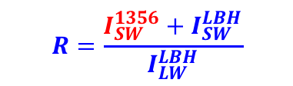

Disk Algorithm
SZA < 20º
$$R=\frac{I_{SW}^{1356}+I_{SW}^{LBH}}{I_{LW}^{LBH}}$$
$∝$ column O/N₂

Slide 7
Check Disk Algorithm vs Limb Algorithm
Limb Algorithm
(All SZA)
Disk Algorithm
(SZA < 20º)

Slide 8
Summary
First attempt at disk algorithm looks very promising
Will measure differences between disk and limb atmospheres 1000-2000 km apart
Multiple bands of column O/N₂ per orbit possible
  ~ 180 stripe points on disk
    In principle, algorithm could be applied to each
    But--individual points may be too noisy

Slide 9
Plans for Disk Algorithm
Expand disk algorithm to include
  all SZA and solar activity
  table lookup or 2-D functional approach
Examine influence of ionospheric emission
O⁺ + e → O* → 135.6 nm
  Possibly a problem in late afternoon observations
Do we need a placeholder for disk column O/N₂ in Level 2 files?

